Slide 1
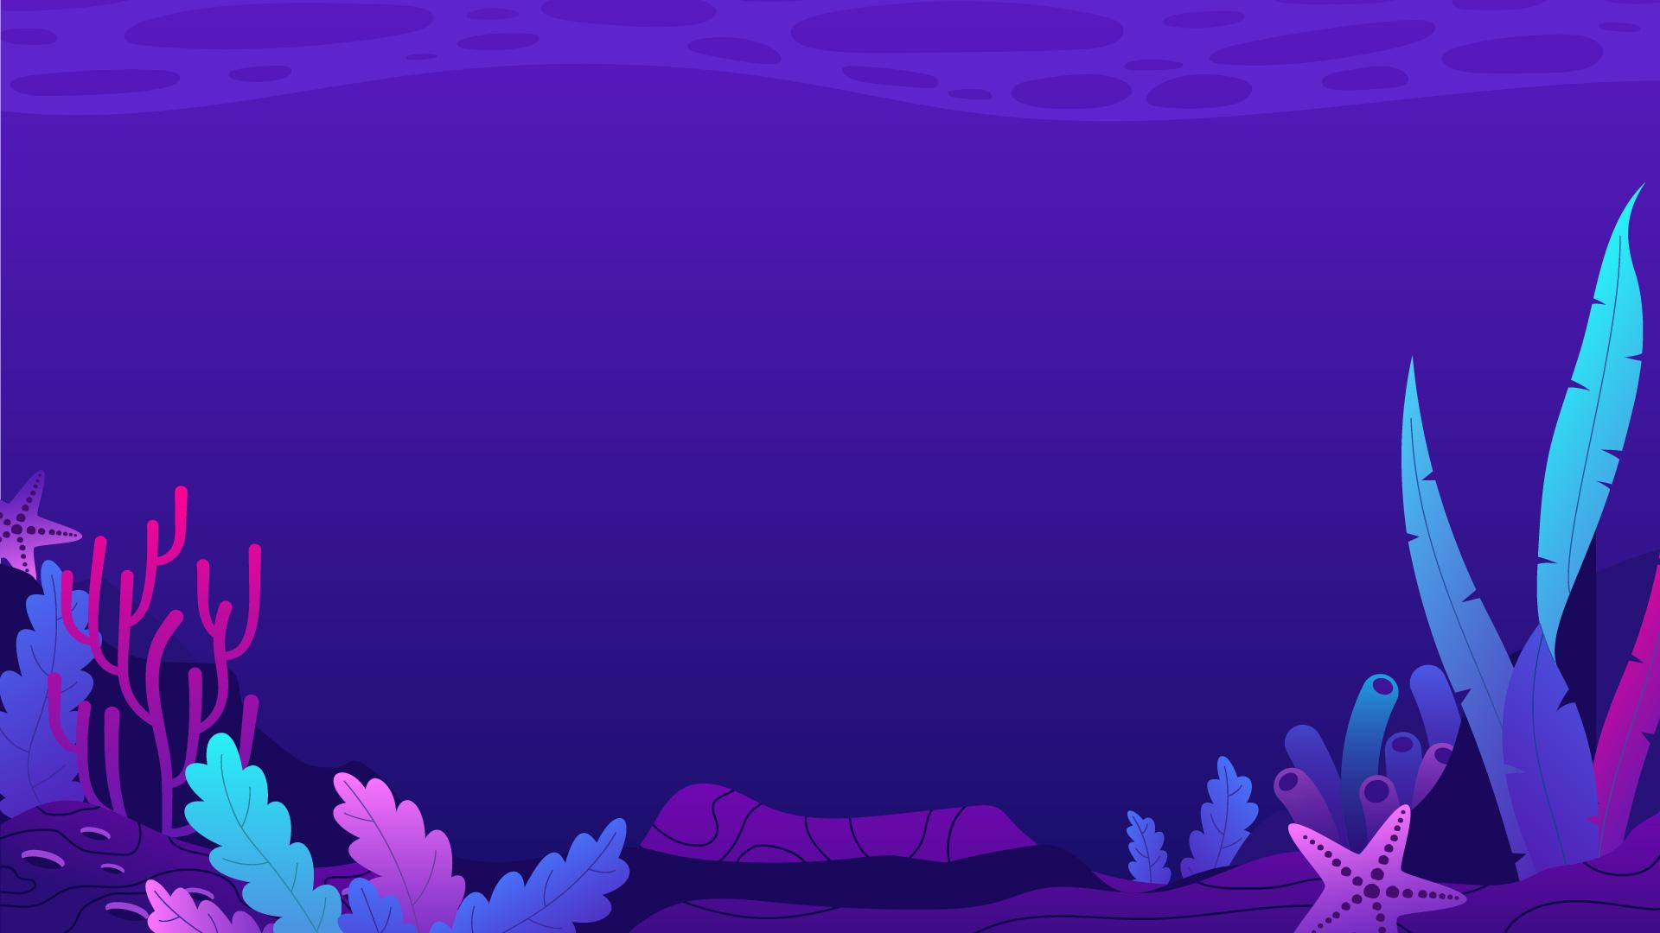
Johannes Daniswara Pratama 5025221276 Teknik Informatika

Slide 2
Main code :
- Aruco Marker (AR TAG)
- Image / Colour detection for landing
- Hand detection
Menggunakan python (karena banyak menggunakan opencv sehinngga lebih cepat buat code nya)
SOURCE CODE DAN List APRIL TAG :
https://github.com/kisenaa/FinalProject_JohannesDaniswaraPratama_5025221276

Slide 3
Update log :
1. Fixed video capture (camera) freeze while doing command
2. Improve code readability and speed
3. Removed uncecessary if else check and loop
4. added if and elif for some code so should improve the loop speed
5. added comments
6. Use 'mavros/setpoint_velocity/cmd_vel_unstamped' for moving drone instead
Using setpoint
7. Drone can be controlled live from camera using april tag, finger, and colour detection
8. Still need to switch mode for each detection
Jika ada error saat kode di run, lakukan ini :
pip install opencv-python==4.4.0.46
pip install opencv-contrib-python==4.4.0.46

Slide 4

ARUCO MARKER
An ArUco marker is a synthetic square marker composed by a wide black border and an inner binary matrix which determines its identifier (id). The black border facilitates its fast detection in the image and the binary codification allows its identification and the application of error detection and correction techniques. The marker size determines the size of the internal matrix. For instance a marker size of 4x4 is composed by 16 bits.

Slide 5
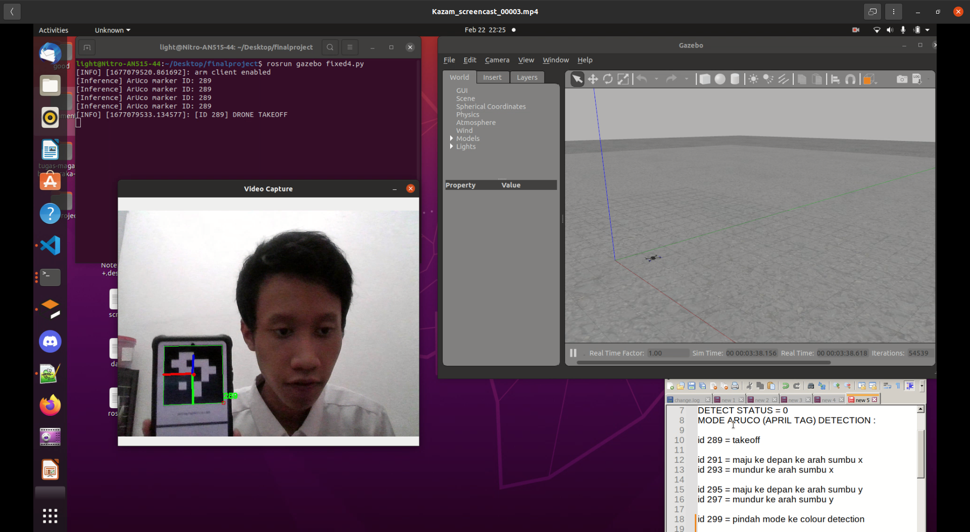

Slide 6
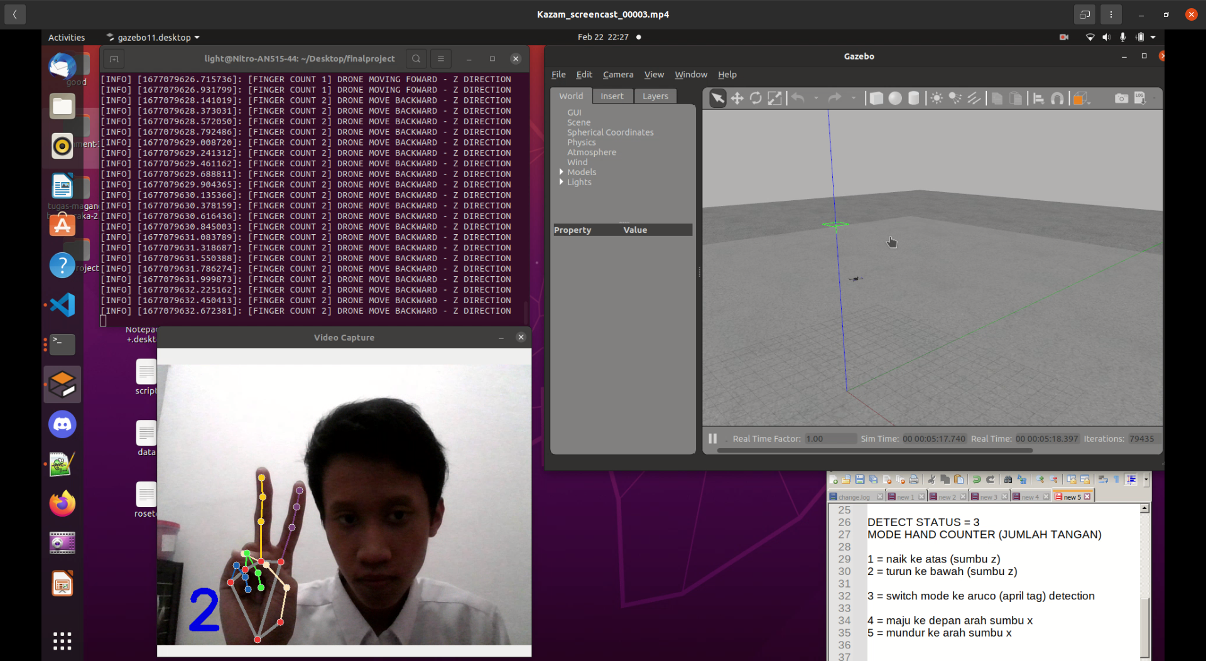
Hand tracking / hand counter

Slide 7
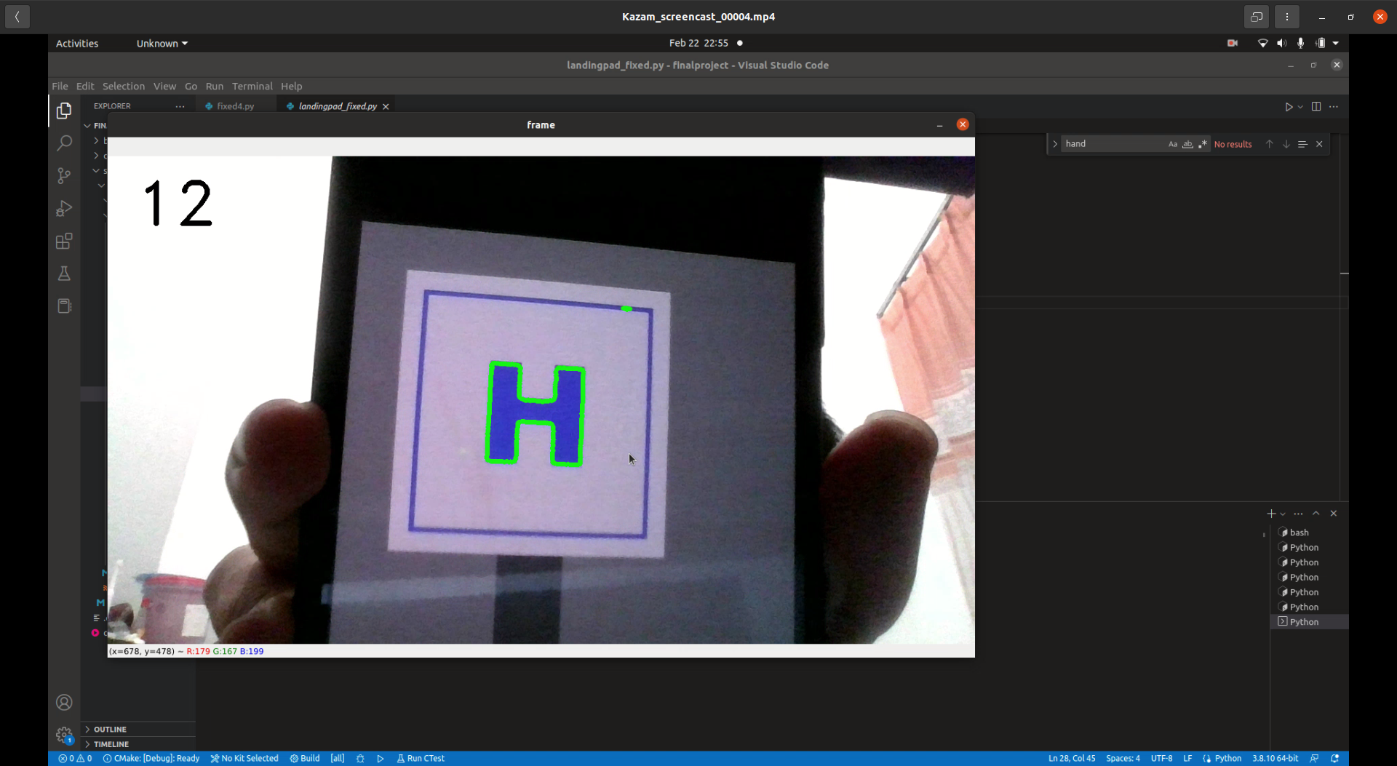
Image detection for landing

Slide 8
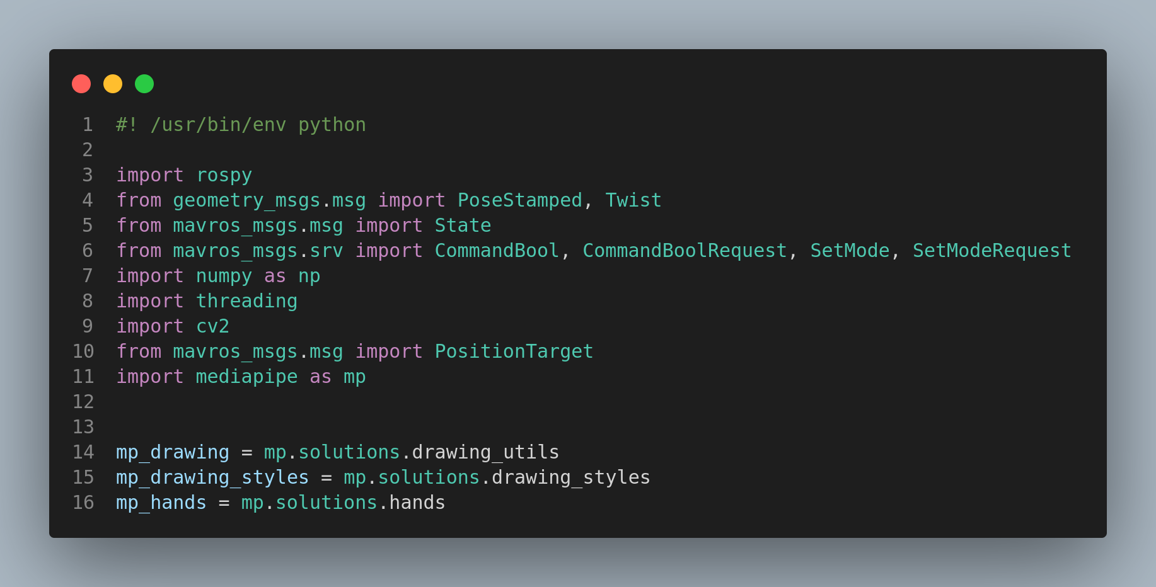

Slide 9
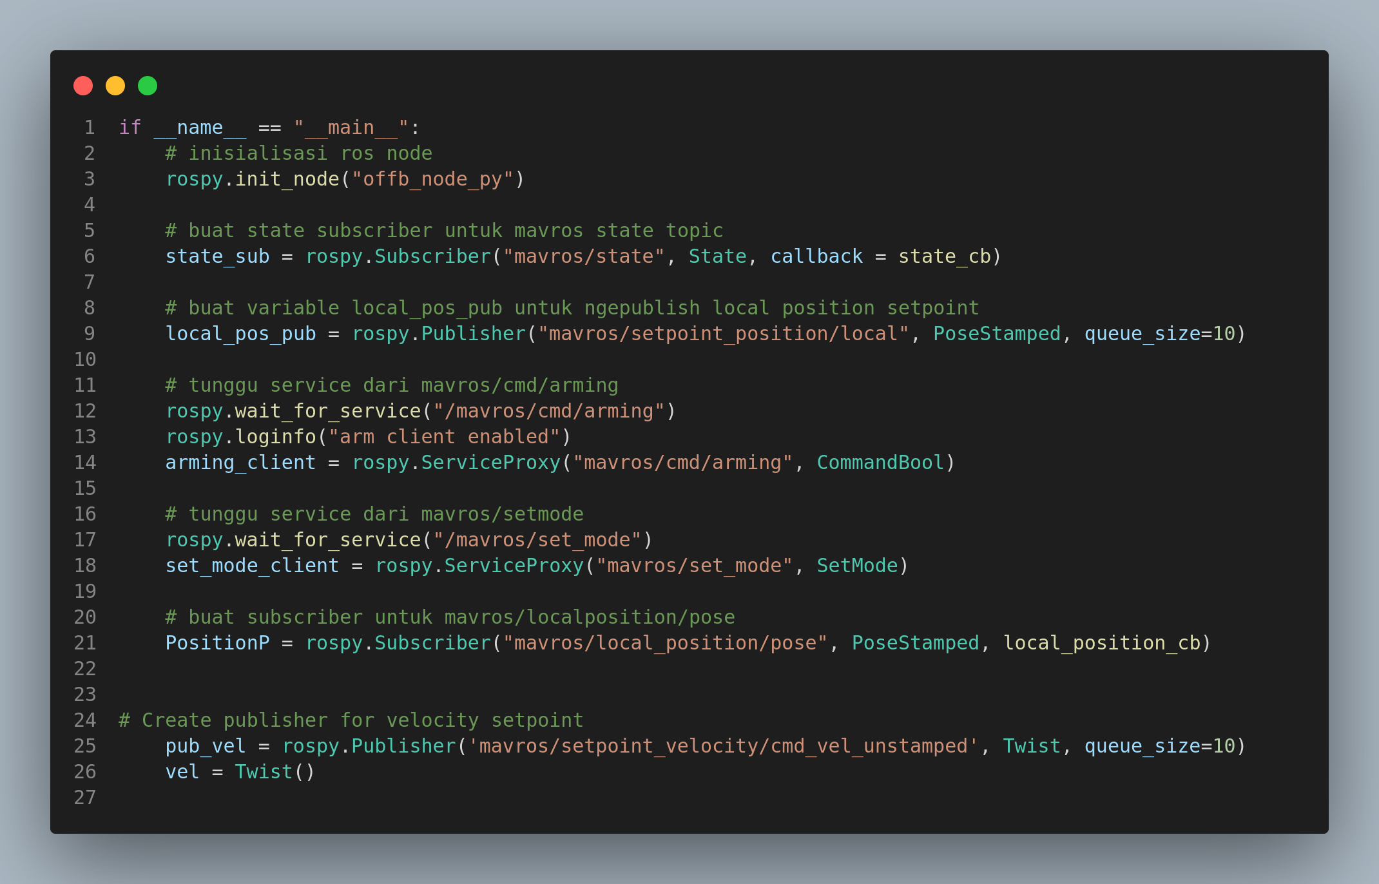

Slide 10
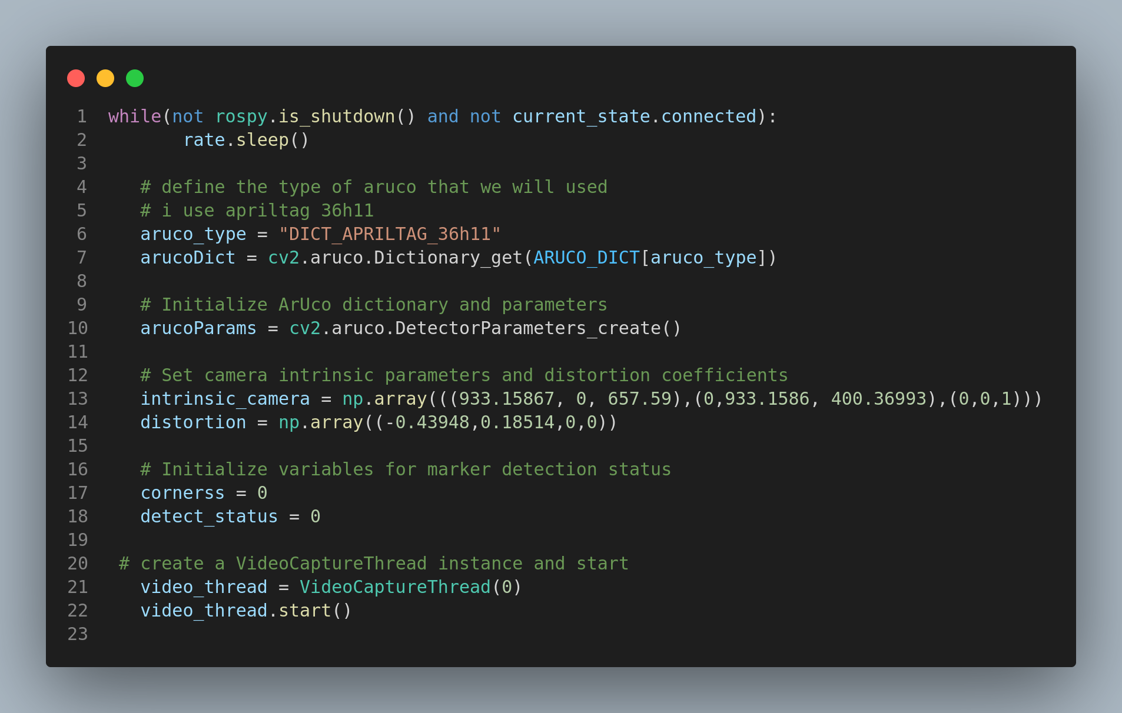

Slide 11
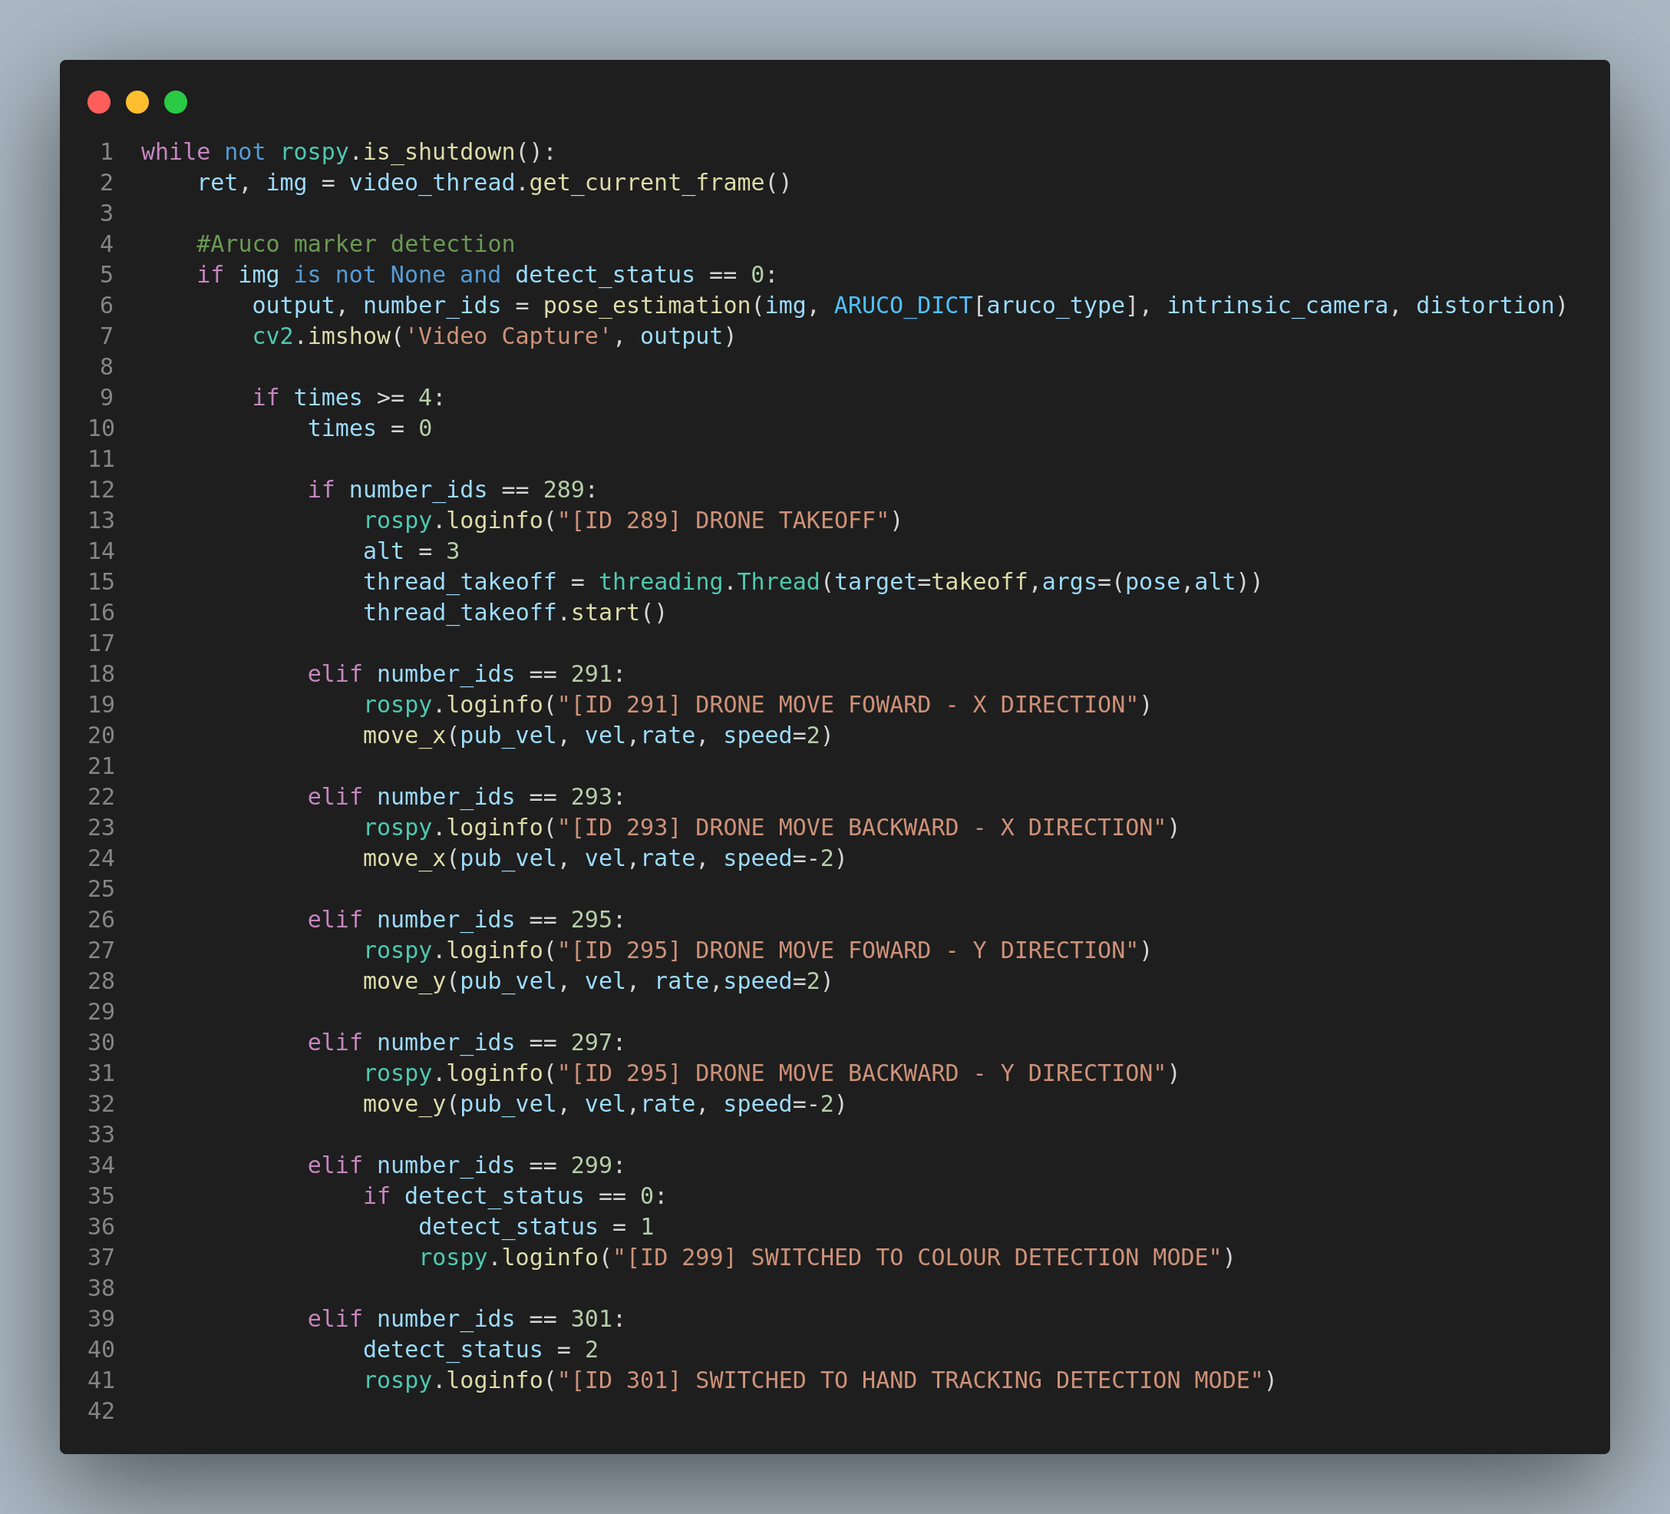

Slide 12
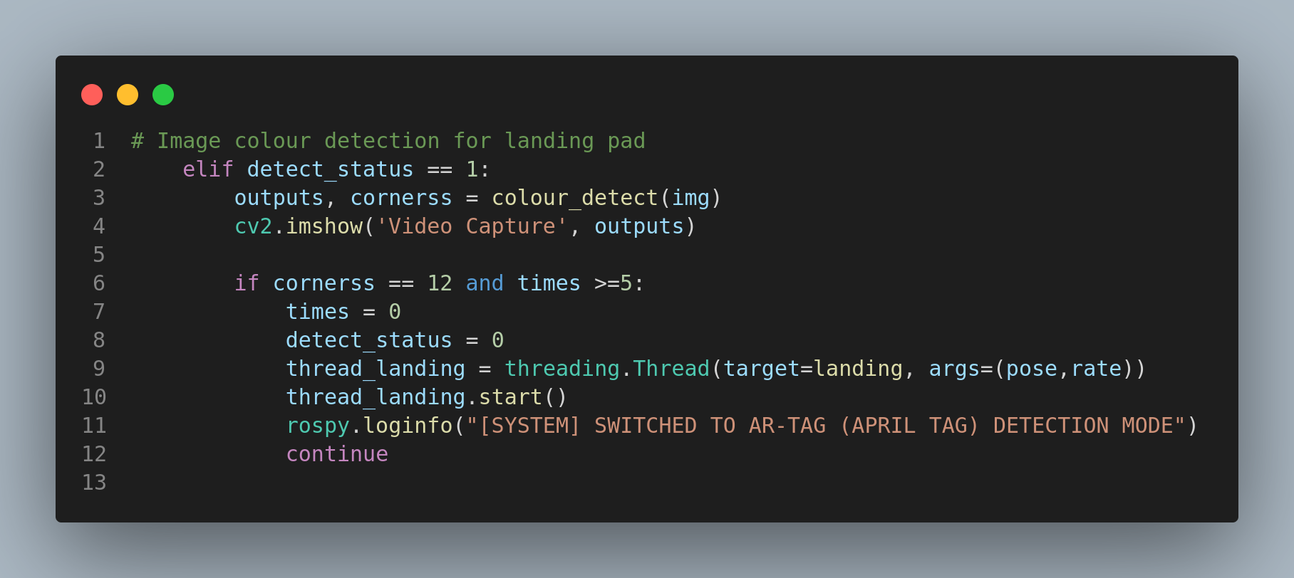

Slide 13
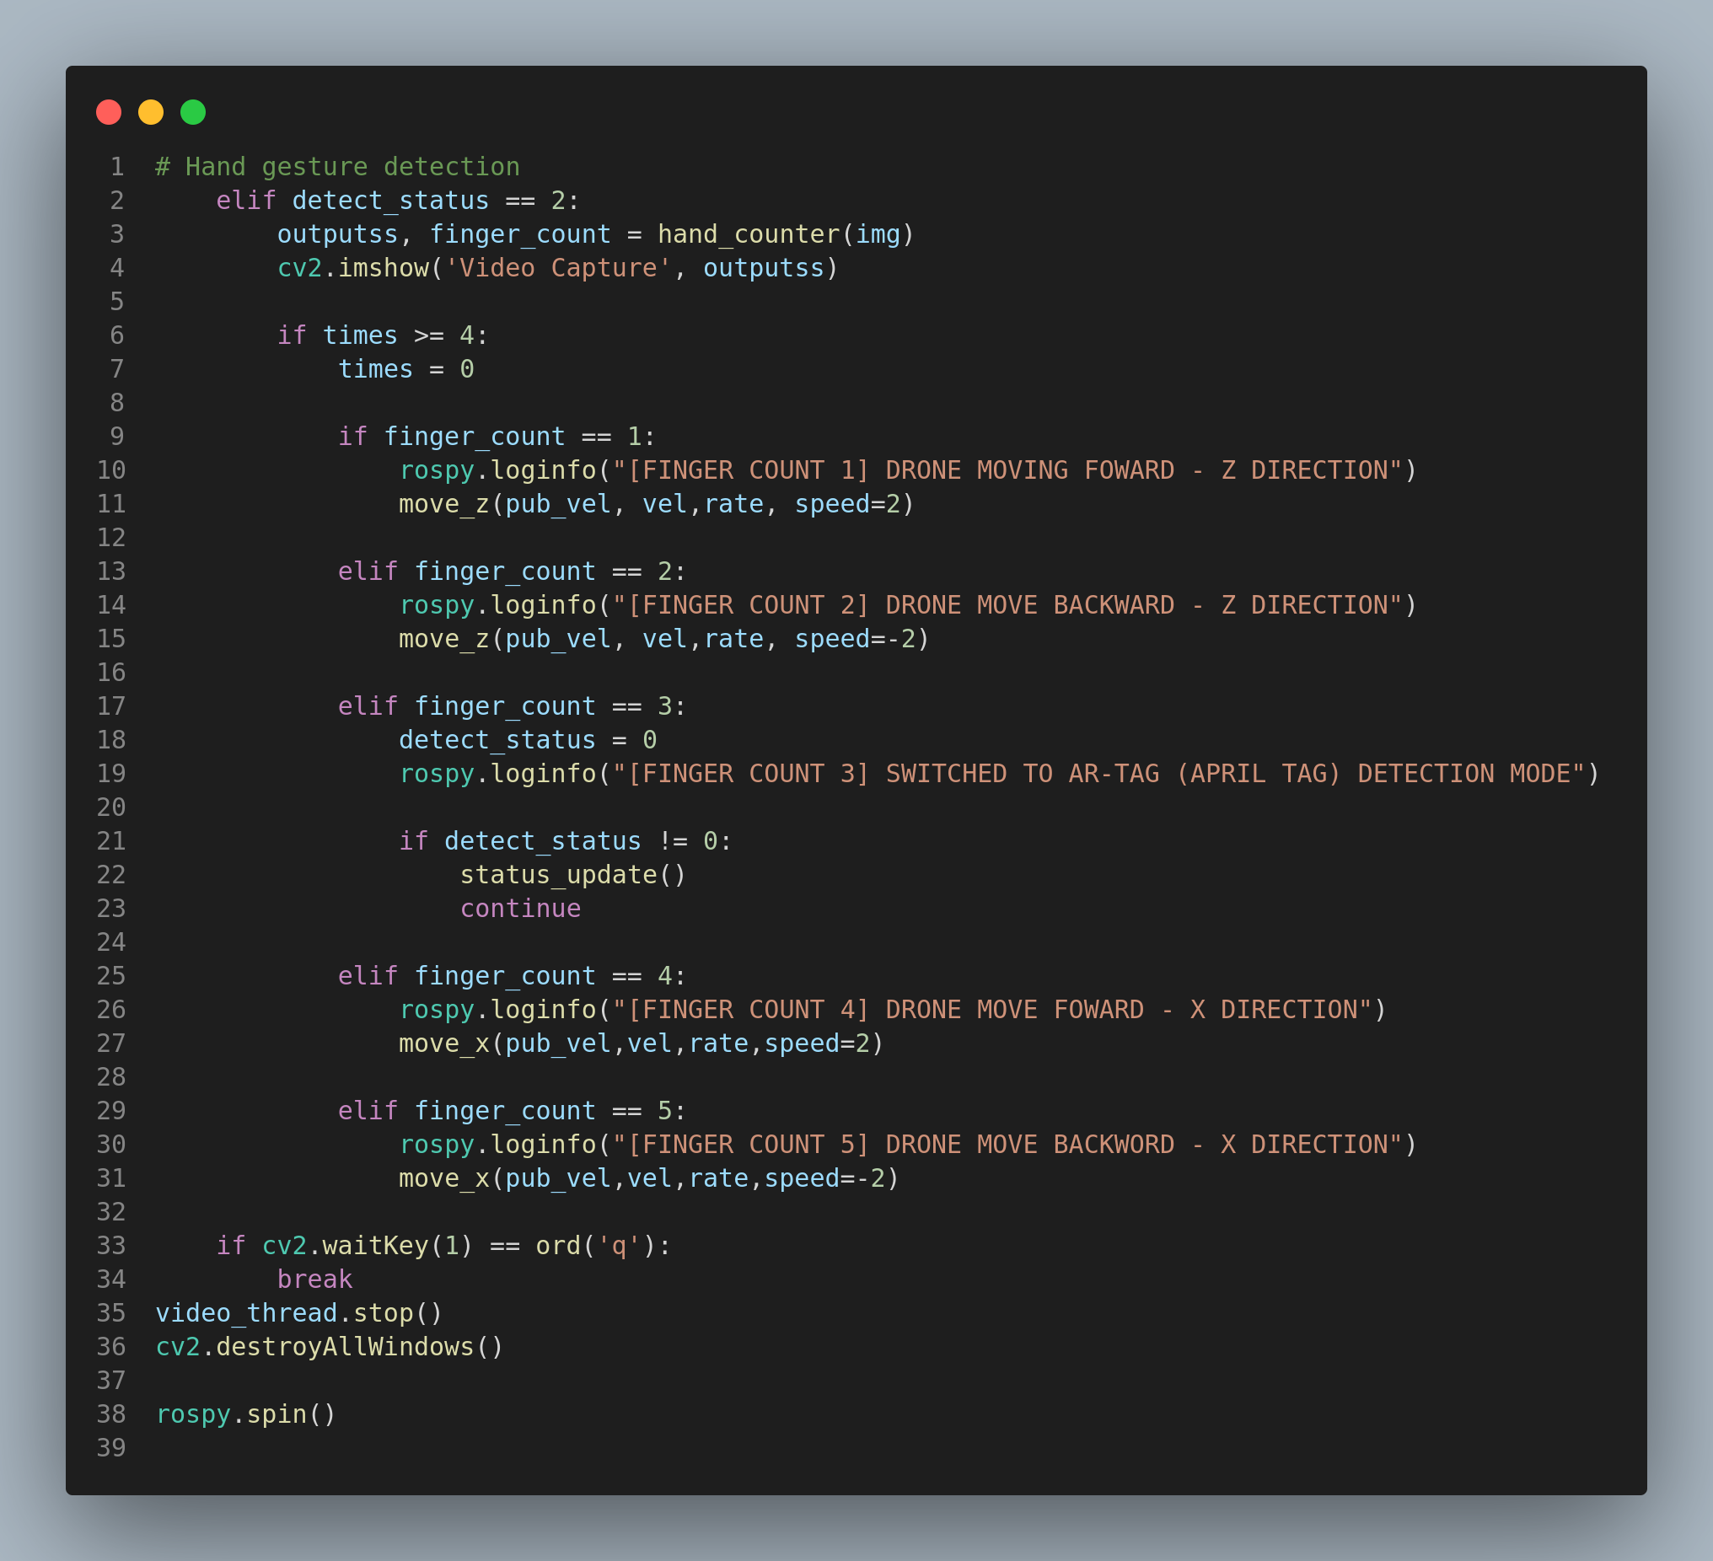

Slide 14
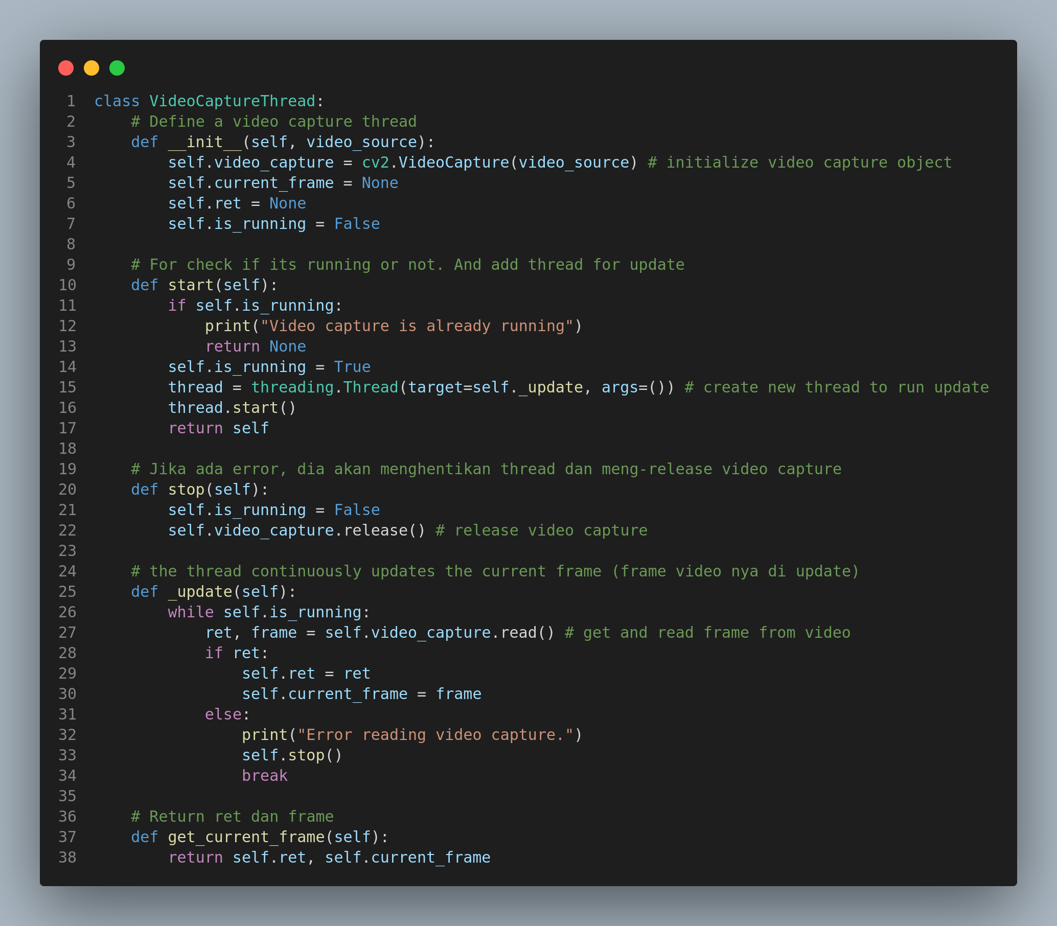

Slide 15
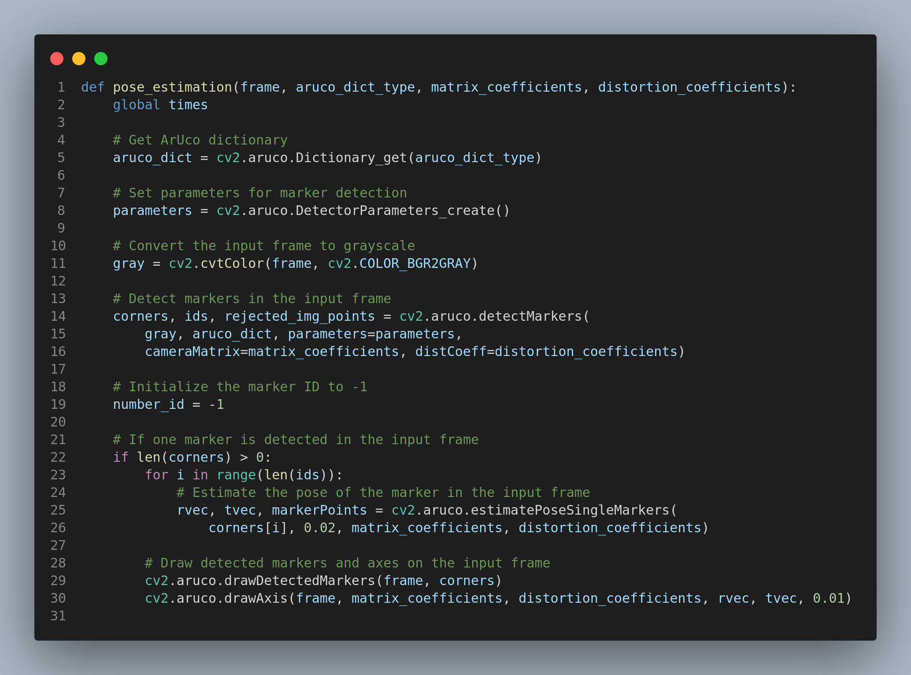

Slide 16
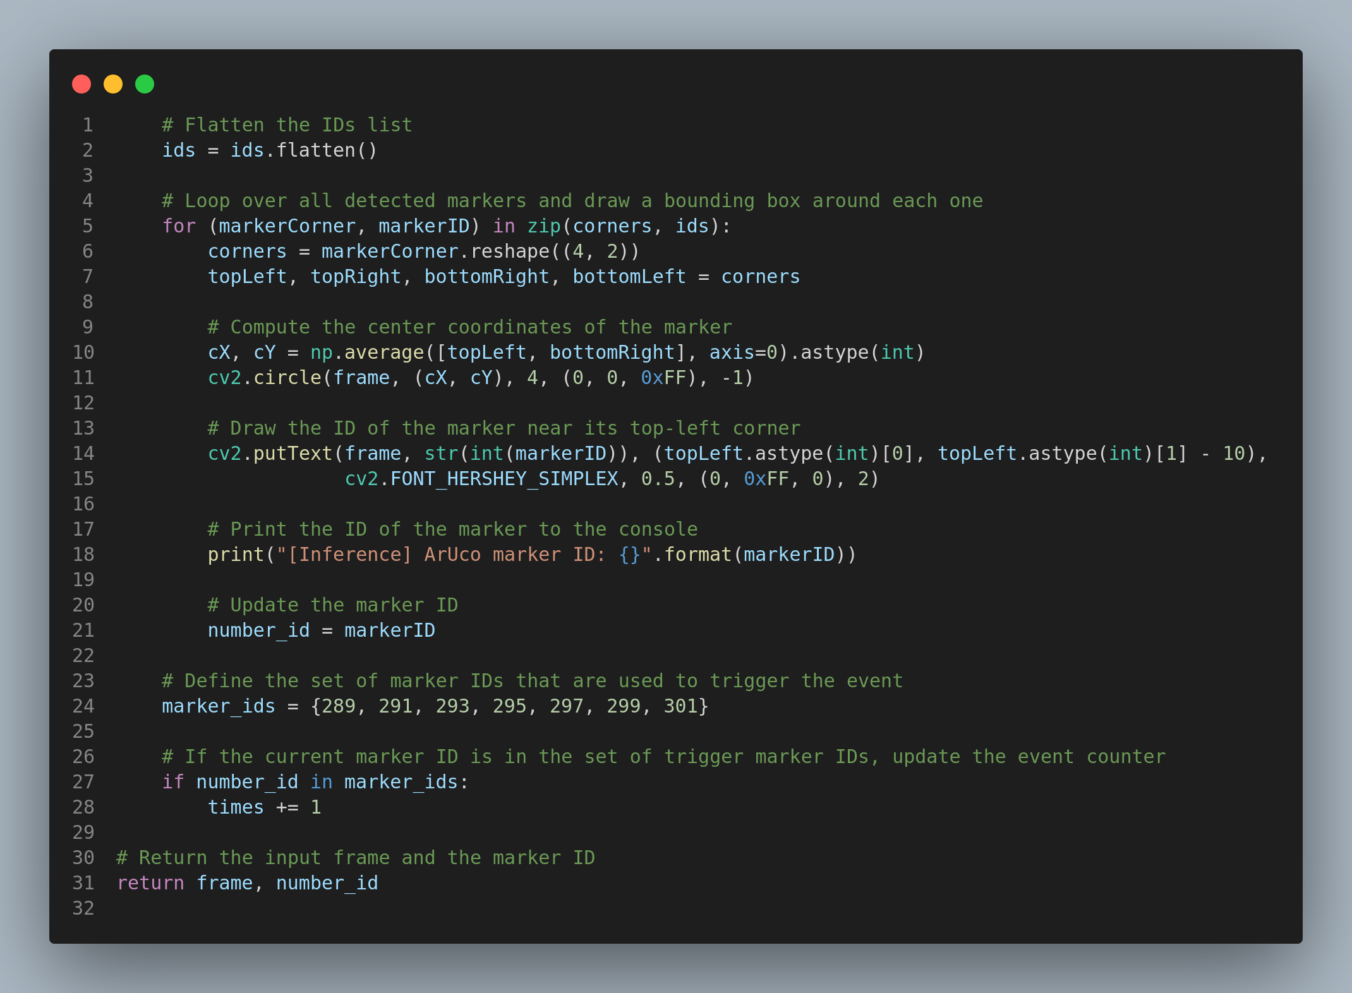

Slide 17
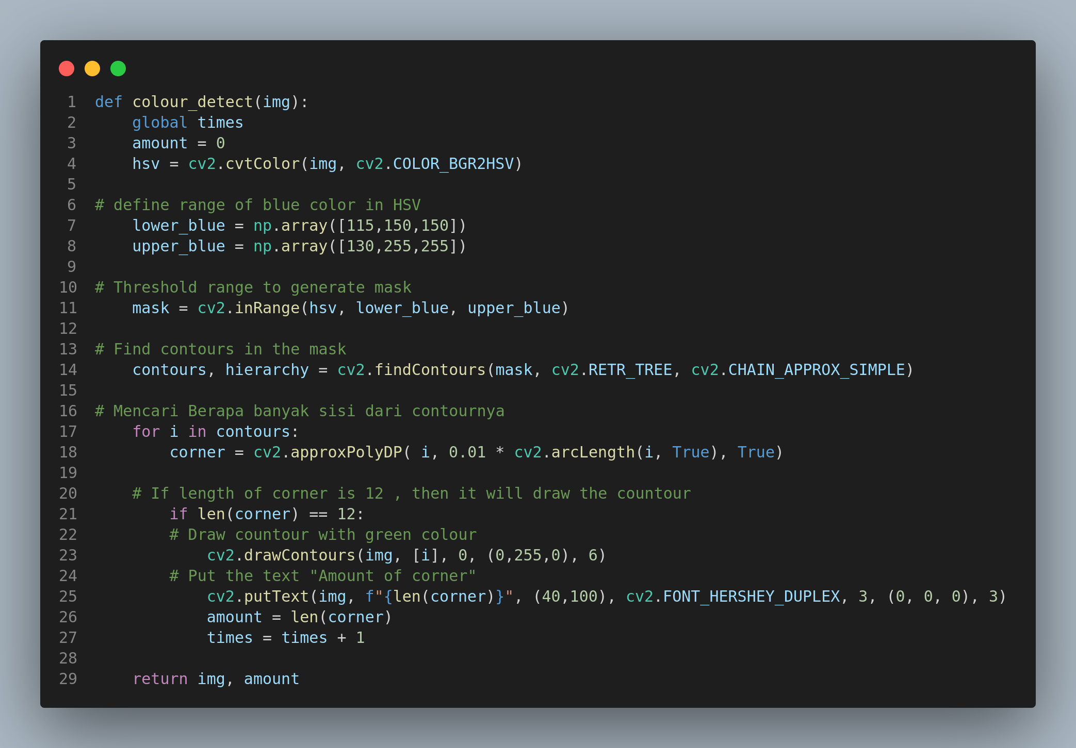

Slide 18
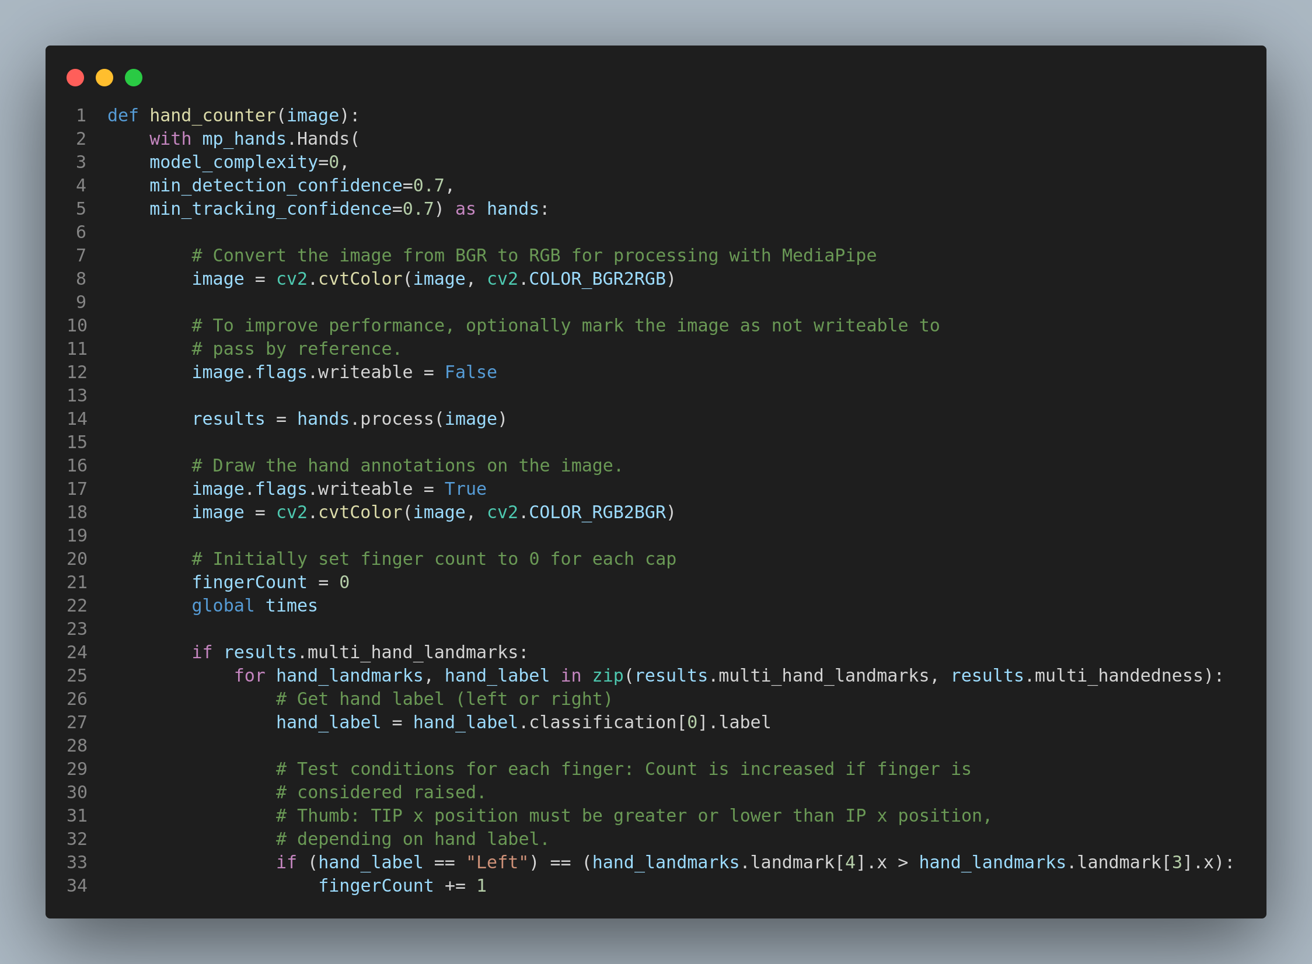

Slide 19
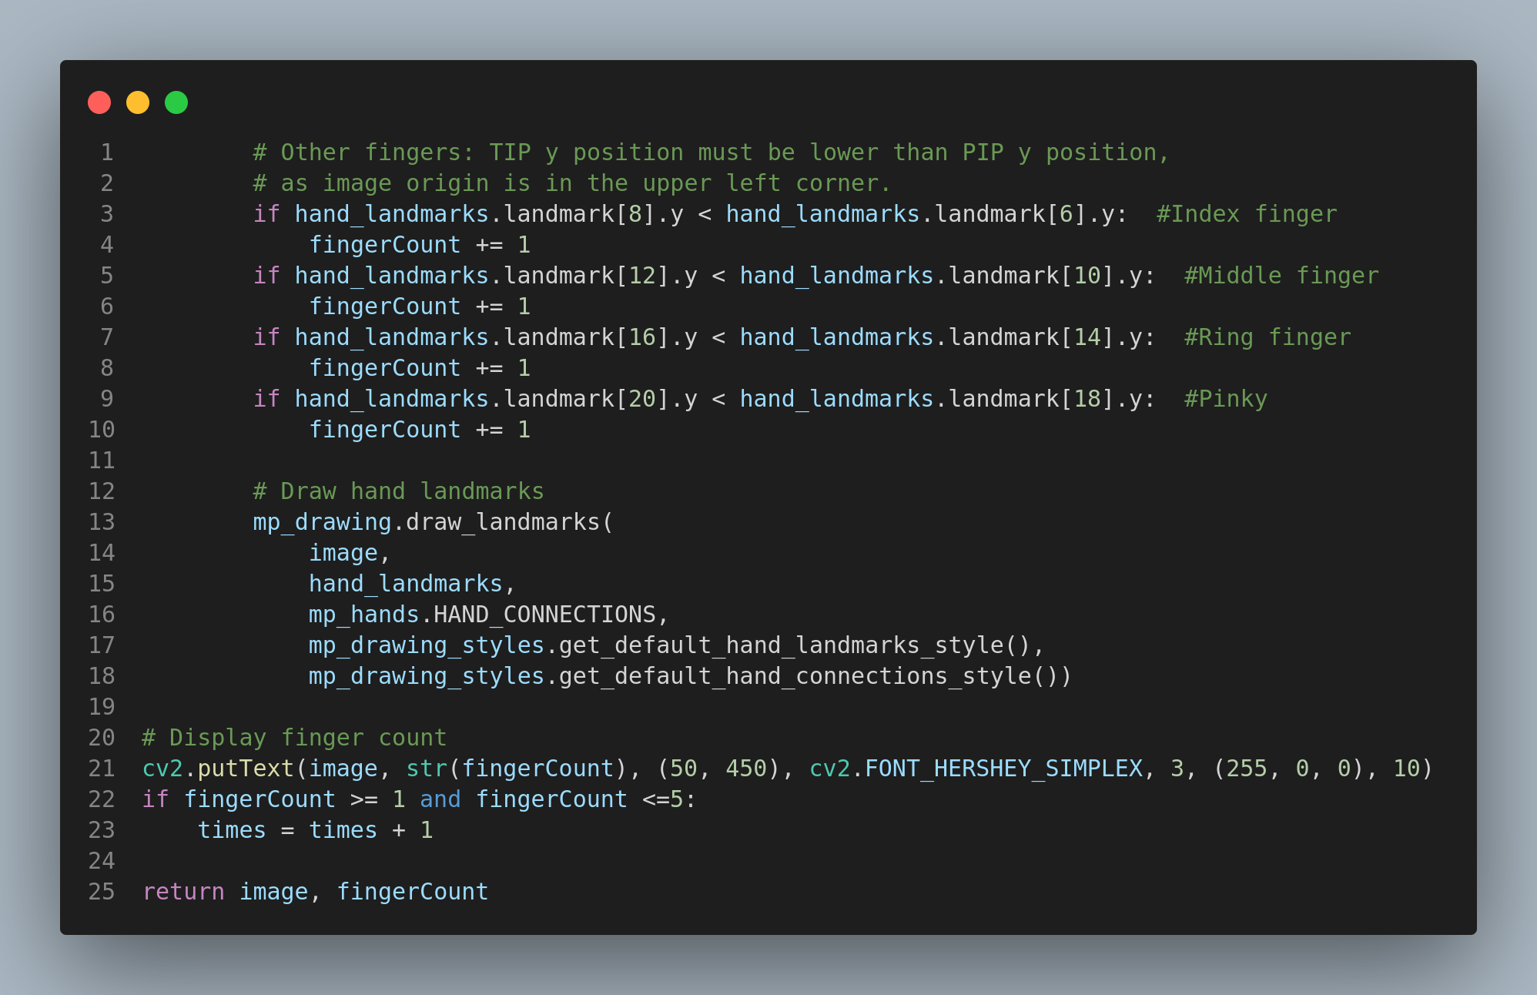

Slide 20
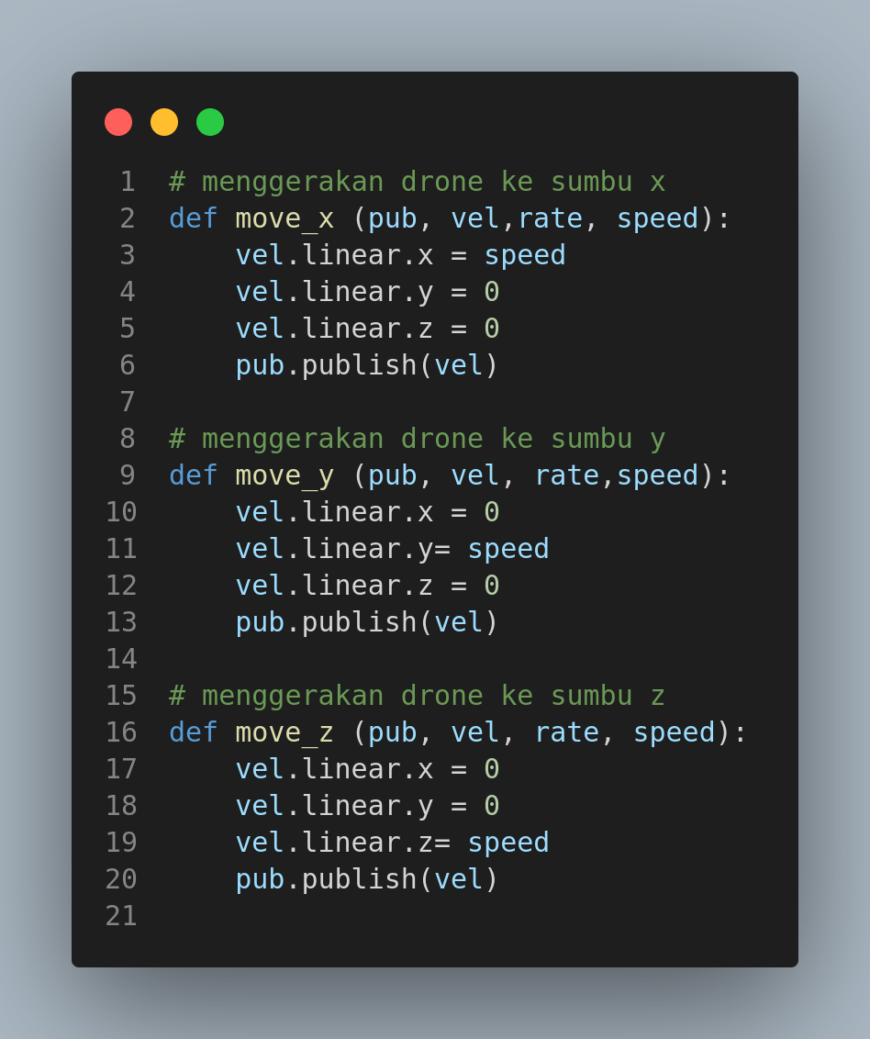

Slide 21
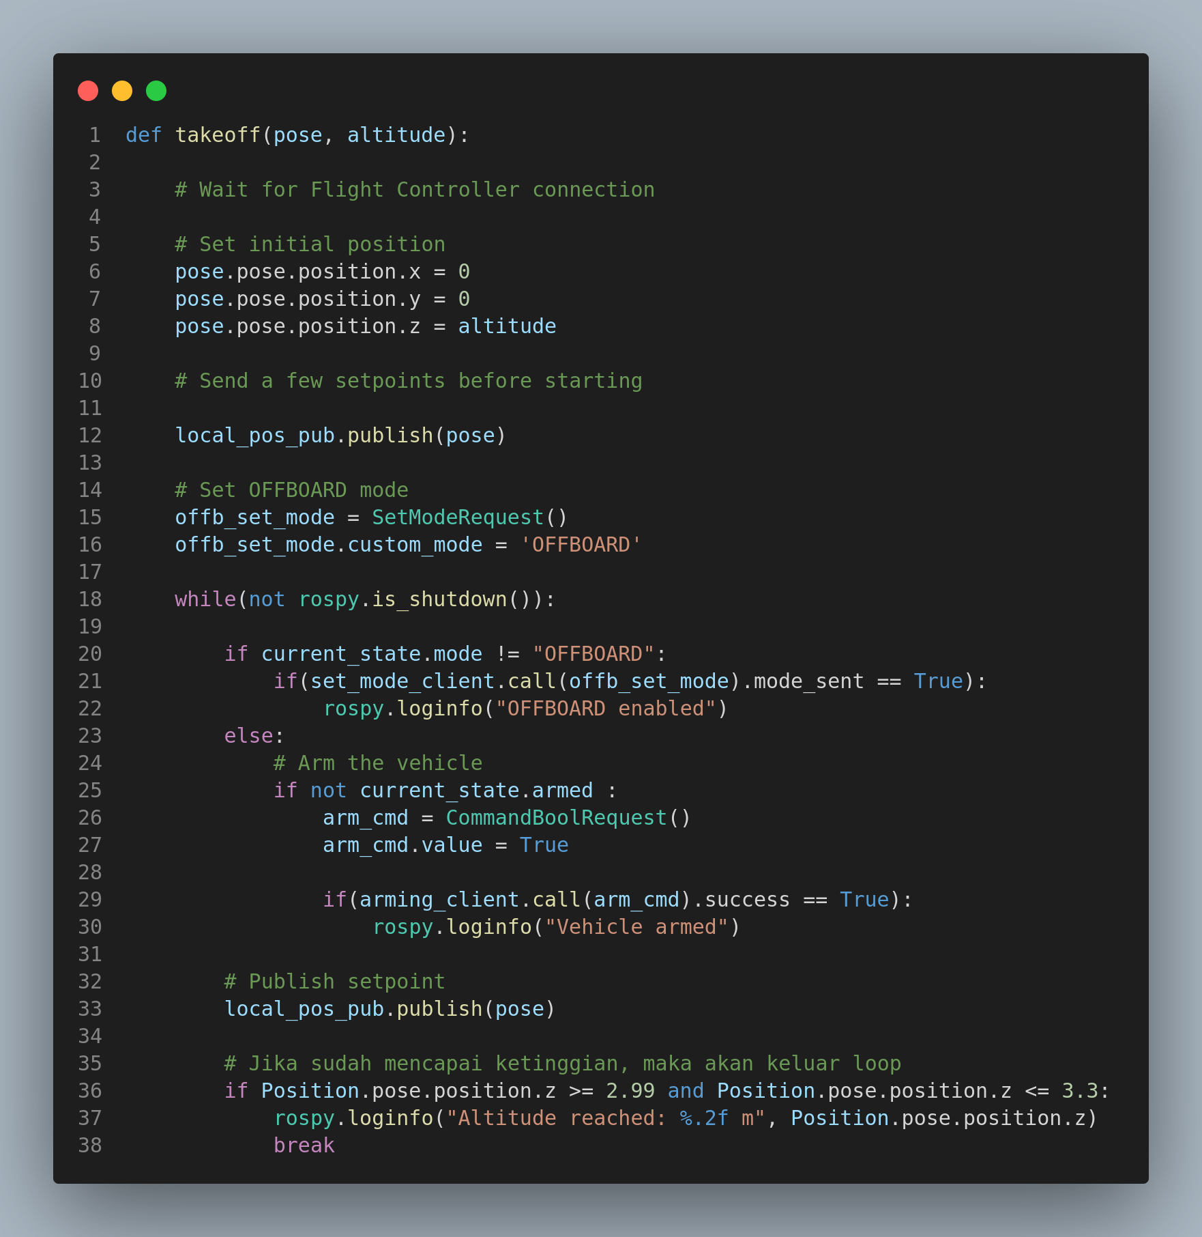

Slide 22
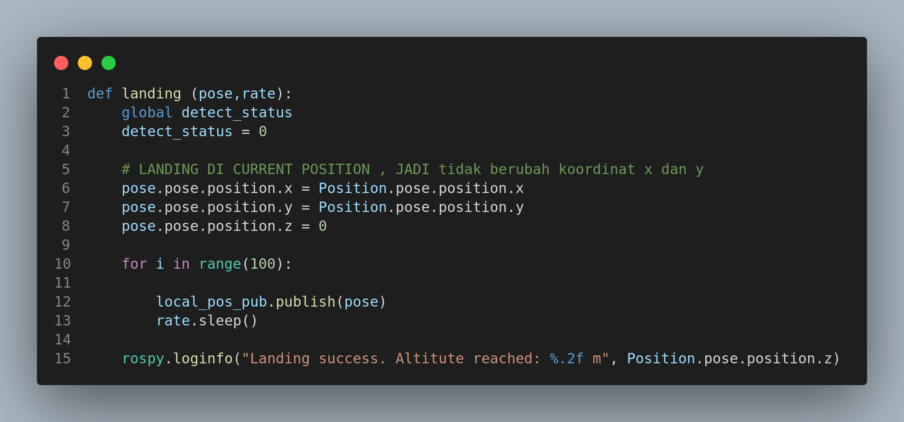

Slide 23
Terimakasih
Maaf atas kekurangan dan salah kata

Slide 24
Underwater coral backgrounds infographics
This template contains an assortment of complementary infographic resources for Underwater Coral Backgrounds presentation
These infographics are adapted to the style of the before mentioned presentation, so you can insert them easily and have the completely integrated at once. You just need to do the following:
Select the element that you want to copy
Right-click and choose “Copy”
Go to the slide where you want the element to appear
Right-click and choose “Paste”

Slide 25
Underwater coral backgrounds infographics
Venus
Mercury
01
04
Venus is the second planet from the Sun
It’s the closest planet to the Sun
Mars
Jupiter
02
03
Despite being red, Mars is cold
It’s the biggest planet of them all

Slide 26
Underwater coral backgrounds infographics
01
Mercury
It’s the closest planet to the Sun
Mars
02
Despite being red, Mars is cold
03
Venus
Venus is the second planet from the Sun

Slide 27
Underwater coral backgrounds infographics
45%
55%
Jupiter
Venus
It’s the biggest planet of them all
Venus is the second planet from the Sun
25%
75%
Earth
Mercury
Earth is the third planet from the Sun
Mercury is a very small planet

Slide 28
Underwater coral backgrounds infographics
Venus
Venus is the second planet from the Sun
Mars
Mars is actually a cold place
Mercury
It’s the closest planet to the Sun

Slide 29
Underwater coral backgrounds infographics
Venus is the second planet from the Sun
Venus
Despite being red, Mars is cold
It’s the closest planet to the Sun
Mars
Mercury

Slide 30
Underwater coral backgrounds infographics
Mars
Jupiter
It’s very cold
It’s a gas giant
Saturn
Mercury
It has rings
It’s very small

Slide 31
Underwater coral backgrounds infographics
Despite being red, Mars is cold
It’s the biggest planet of them all
Mars
Jupiter
Saturn
Mercury
Saturn is a gas giant and has rings
It’s the closest planet to the Sun

Slide 32
Underwater coral backgrounds infographics
Fish sighting - first semester 2XXX
Jan | Feb | Mar | Apr | May | Jun
Mercury
Saturn
Jupiter
It’s very small
It’s a gas giant
It’s very big

Slide 33
Underwater coral backgrounds infographics
Mercury
It’s the closest planet to the Sun
Mars
Despite being red, Mars very is cold
Jupiter
It’s the biggest planet of them all
Venus
Venus has a very beautiful name

Slide 34
Underwater coral backgrounds infographics
01
Mercury
02
Jupiter
03
Venus
It’s the closest planet to the Sun
It’s the biggest planet of them all
Venus has a beautiful name

Slide 35
Underwater coral backgrounds infographics
Neptune
Venus
Jupiter
Mars
Venus is the second planet from the Sun
It’s the biggest planet of them all
Despite being red, Mars is cold

Slide 36

Underwater coral backgrounds infographics
Mercury
Venus
It’s very small
It’s very hot
Evolution
Despite being red, Mars is actually a cold place. It’s full of iron oxide dust
Follow the link in the graph to modify its data and then paste the new one here. For more info, click here

Slide 37
Underwater coral backgrounds infographics
Mars | Venus | Mercury | Jupiter
Mars is actually a cold place | Venus has a beautiful name | Mercury is a very small planet | Jupiter is an enormous planet
Neptune is far away from us | Earth is the planet with life | Saturn was named after a god | Pluto is now a dwarf planet

Slide 38
Underwater coral backgrounds infographics
75%
50%
25%
Venus
Mars
Jupiter
Venus has a nice name
Mars is a very cold place
Jupiter is a huge planet

Slide 39
Underwater coral backgrounds infographics
01
03
02
04
Mars
Mercury
Despite being red, Mars is cold
Venus
It’s the closest planet to the Sun
Jupiter
Venus has a beautiful name
Jupiter is a huge gas giant

Slide 40
Underwater coral backgrounds infographics
Mars
Despite being red, Mars is cold
Venus is very hot
We all live on Earth
It’s the biggest planet of them all
Jupiter

Slide 41
Underwater coral backgrounds infographics
25%
Jupiter
50%
Mars
Jupiter is a very big planet
Mars is a very cold place
75%
Venus
100%
Saturn
Venus has a beautiful name
Saturn has several rings

Slide 42
Underwater coral backgrounds infographics
2/5
Venus
It’s extremely hot
4/5
Mars
It’s a very cold planet
3/5
Earth
We all live on Earth
5/5
Pluto
It’s a dwarf planet

Slide 43
Underwater coral backgrounds infographics
Mars
Venus
Mercury
Jupiter
Despite being red, Mars is cold
Venus has a beautiful name
It’s the closest planet to the Sun
Jupiter is a very big planet
2XXX
2XXX
2XXX
2XXX

Slide 44
Underwater coral backgrounds infographics
Species | Year | Number | Extinction
Venus | 2XXX | 20,000 | No
Neptune | 2XXX | 30,000 | Yes
Saturn | 2XXX | 45,000 | No
Jupiter | 2XXX | 25,000 | Yes
Mars | 2XXX | 50,000 | Yes

Slide 45
Underwater coral backgrounds infographics
Mars
Despite being red, Mars is cold
Jupiter
Mercury
Venus
Venus is a very hot planet
Jupiter is an enormous planet
It's the closest planet to the Sun
Saturn
Saturn is a gas giant with rings

Slide 46
Underwater coral backgrounds infographics
Venus
Saturn
It’s a hot planet
It has many rings
35%
35,000
65%
65,000
Despite being red, Mars is cold
Jupiter is an enormous planet

Slide 47
Underwater coral backgrounds infographics
Mercury
It’s very small
Mars
It’s very cold
Jupiter
It’s very big
Saturn
It’s a gas giant

Slide 48
Underwater coral backgrounds infographics
Earth
Earth is a planet that has life
Mars
Despite being red, Mars is cold
Saturn
Saturn is a gas giant with rings
Mercury
It’s the closest planet to the Sun

Slide 49
Underwater coral backgrounds infographics
60%
40%
Venus
Mercury
Venus has a beautiful name
Mercury is a small planet
10%
Saturn
30%
Mars
Saturn has several rings
Despite being red, Mars is cold

Slide 50
Instructions for use
If you have a free account, in order to use this template, you must credit Slidesgo in your final presentation. Please refer to the next slide to read the instructions for premium users.
As a Free user, you are allowed to:
- Modify this template.
- Use it for both personal and commercial projects.
You are not allowed to:
- Sublicense, sell or rent any of Slidesgo Content (or a modified version of Slidesgo Content).
- Distribute Slidesgo Content unless it has been expressly authorized by Slidesgo.
- Include Slidesgo Content in an online or offline database or file.
- Offer Slidesgo templates (or modified versions of Slidesgo templates) for download.
- Acquire the copyright of Slidesgo Content.
For more information about editing slides, please read our FAQs or visit our blog:
https://slidesgo.com/faqs and https://slidesgo.com/slidesgo-school

Slide 51
Instructions for use (premium users)
As a Premium user, you can use this template without attributing Slidesgo.
You are allowed to:
Modify this template.
Use it for both personal and commercial purposes.
Share this template in an editable format with people who are not part of your team.
You are not allowed to:
Sublicense, sell or rent this Slidesgo Template (or a modified version of this Slidesgo Template).
Distribute this Slidesgo Template (or a modified version of this Slidesgo Template) or include it in a database or in any other product or service that offers downloadable images, icons or presentations that may be subject to distribution or resale.
Use any of the elements that are part of this Slidesgo Template in an isolated and separated way from this Template.
Register any of the elements that are part of this template as a trademark or logo, or register it as a work in an intellectual property registry or similar.
For more information about editing slides, please read our FAQs or visit our blog:
https://slidesgo.com/faqs and https://slidesgo.com/slidesgo-school

Slide 52
Infographics
You can add and edit some infographics to your presentation to present your data in a visual way.
Choose your favourite infographic and insert it in your presentation using Ctrl C + Ctrl V or Cmd C + Cmd V in Mac.
Select one of the parts and ungroup it by right-clicking and choosing “Ungroup”.
Change the color by clicking on the paint bucket.
Then resize the element by clicking and dragging one of the square-shaped points of its bounding box (the cursor should look like a double-headed arrow). Remember to hold Shift while dragging to keep the proportions.
Group the elements again by selecting them, right-clicking and choosing “Group”.
Repeat the steps above with the other parts and when you’re done editing, copy the end result and paste it into your presentation.
Remember to choose the “Keep source formatting” option so that it keeps the design. For more info, please visit our blog.

